Slide 1
Software Engineering UML
CS 1530
Summer 2020
Instructor: Sohel Sarwar
University of Pittsburgh
Lecture 5 UML

Slide 2
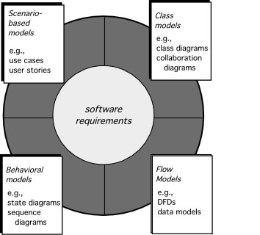

Modeling A System’s Architecture

Slide 3
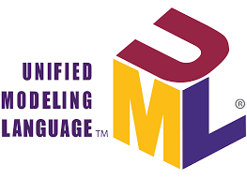
Software Design
Modeling
The Unified Modeling Language (UML) is a standard language for writing software blueprints. The UML may be used to visualize, specify, construct, and document the artifacts of a software intensive system.
The UML is only a language and so is just one part of a software development method.
Three major elements of model:
the UML's basic building blocks,
the rules that dictate how those building blocks may be put together,
some common mechanisms that apply throughout the UML.

Slide 4
Software Design
Modeling
Aims of modeling:
Models help us to visualize a system as it is or as we want it to be.
Models permit us to specify the structure or behavior of a system.
Models give us a template that guides us in constructing a system.
Models document the decisions we have made.

Slide 5
Software Design
Modeling
Building Blocks of the UML
Things (entities)
Relationships
Diagrams

Slide 6
Software Design
Modeling
Entities of the UML
Entities are the elements of models.
All UML entities can be divided into:
structural entities - nouns UML models, such as class, interface, cooperation, precedent, the active class, component, unit,
behavioral entities - verbs UML models, such as interaction, activity, machines; grouping the essence of the package that is used for grouping semantically related elements of the model in forming a single whole modules;
summary entity - note, which can be added to the model to record specific information, very much like the sticker.

Slide 7
Software Design
Modeling
Structural Entities of the UML
Structural entities are the nouns of UML models. These are the mostly static parts of a model, representing elements that are either conceptual or physical.
Class
Interface
Collaboration
Use case

Slide 8
Software Design
Modeling
Relationships in UML
Dependency
Association
Generalization
Realization

Slide 9




Relationships in UML
Software Design
Modeling
Type of relationship | UML syntax Source – Target | Semantics
Dependency |  | Source element depends on the target element and change last may affect the first.
Association |  | Description of the set of relationships between objects.
Aggregation |  | The target element is a part of the source (container) element. But the target can sustain without the existence of the source (container).
Composition |  | The target element is a part of the source (container) element. But the target can’t sustain without the existence of the source (container).

Slide 10



Software Design
Modeling
Relationships in UML
Type of relationship | UML syntax Source – Target | Semantics
Inclusion |  | Source element contains the target element.
Generalization |  | The source element is a specialization of a more generalized (the target) element; and can replace him.
Realization |  | The original item is guaranteed to perform the contract, a certain target element.
https://www.uml-diagrams.org/class-reference.html

Slide 11


Software Design
Modeling
Realization Relationship in java code
public interface LivingEntityInterface{
Bird bird = new Bird();
public void fly();
public void run();
public void swim();
}
public abstract class LivingEntity implements LivingEntityInterface{
protected final String feature = "LIVING";
protected int legs;
protected int wings;
protected abstract void setEat(String val);
public abstract String getEat();
….
}

Slide 12

Software Design
Modeling
Generalization Relationship in java code
public class Animal extends LivingEntity{
protected void setEat(String val) {
food = val;
}
public String getEat() {
return food;
}
…
}

Slide 13
Aggregation & Composition Relationships in java code
Software Design
Modeling
public class Student{
Department dept;
Address addr = new Address();
Student (Department var) {
dept = var;
}
private void populateAddress(){
/* populate the address information in
the addr attribute;
*/
}
}
Department
Student
Address

Slide 14


Diagrams in the UML
A diagram is the graphical presentation of a set of elements, most often rendered as a connected graph of vertices (things) and arcs (relationships).

Slide 15
Diagrams in the UML
Class diagram
Object diagram
Use case diagram
Sequence diagram
Collaboration diagram
Statechart diagram
Activity diagram
Component diagram
Deployment diagram

Slide 16

Class diagrams
A class diagram shows a set of classes, interfaces, and collaborations and their relationships.
These diagrams are the most common diagram found in modeling object-oriented systems. Class diagrams address the static design view of a system. Class diagrams that include active classes address the static process view of a system.

Slide 17
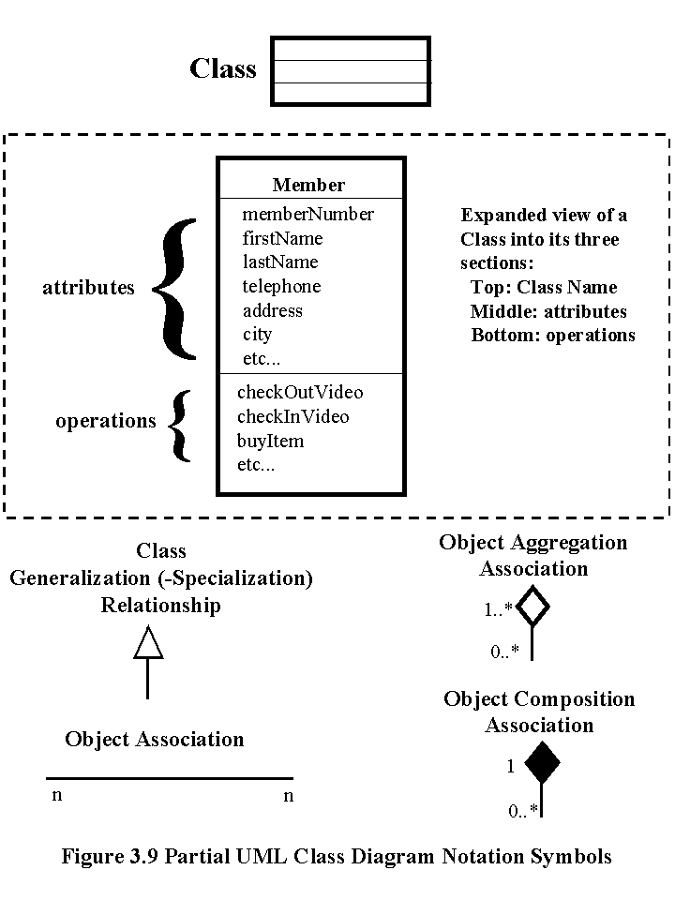
Class Diagram

Slide 18
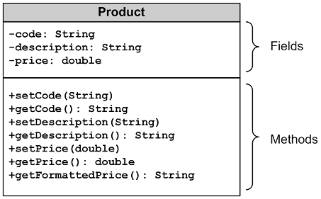
Class Diagram

Slide 19
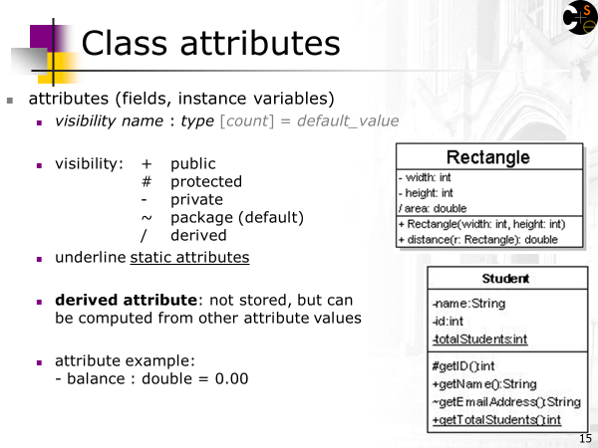
Class Diagram

Slide 20
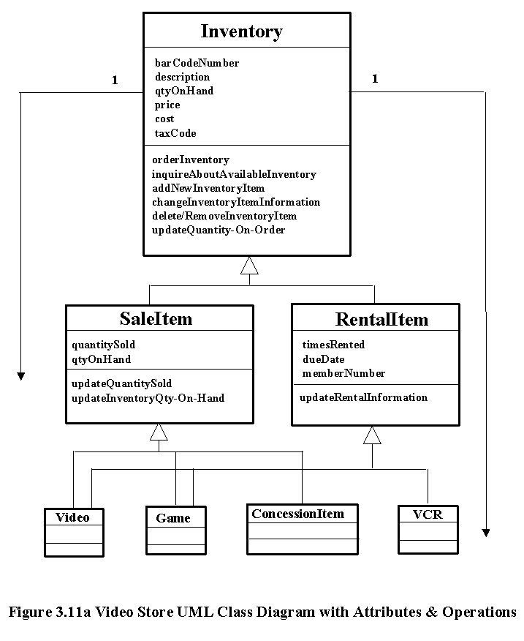
Class Diagram

Slide 21
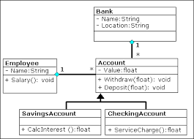
Class Diagram

Slide 22
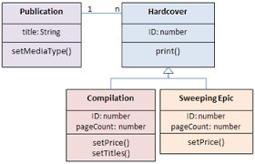
Class Diagram

Slide 23
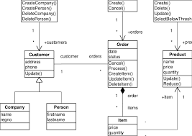
Class Diagram

Slide 24
Object Diagram
An object diagram shows a set of objects and their relationships. Object diagrams represent static snapshots of instances of the things found in class diagrams. These diagrams address the static design view or static process view of a system as do class diagrams, but from the perspective of real or prototypical cases.

Slide 25

Use case diagram
A use case diagram shows a set of use cases and actors (a special kind of class) and their relationships. Use case diagrams address the static use case view of a system. These diagrams are especially important in organizing and modeling the behaviors of a system.

Slide 26
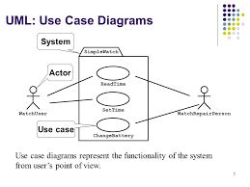
Use Case Diagram

Slide 27
Use Case Diagram
A set of ACTORS : roles users can play in interacting with the system.
An actor is used to represent something that users our system.
A set of USE CASES: each describes a possible kind of interaction between an actor and the system.
Uses cases are actions that a user takes on a system
A number of RELATIONSHIPS between these entities (Actors and Use Cases).
Relationships are simply illustrated with a line connecting actors to use cases.

Slide 28
Use Case Diagram
An actor is a user of the system playing a particular role.
Actor is shown with a stick figure.
employer
employee
client

Slide 29
Use Case Diagram
Use case is a particular activity a user can do on the system.
Use Case is represented by an ellipse.
Following are two use cases for a library system.
Borrow
Reserve

Slide 30
Use Case Diagram
Use Case Diagrams - Relationships
Inclusion
Inclusion enables to reuse one use case's steps inside another use case.
Extension
Allows creating a new use case by adding steps to existing use cases
Generalization
Allows child use cases to inherit behavior from parent use cases

Slide 31
Use Case Diagram
Use Case Diagrams – Inclusion Relationship
<<includes>>
Restock
Open Machine
<<includes>>
Close Machine
<<includes>>
Collect
Open Machine
<<includes>>
Close Machine
31

Slide 32
Use Case Diagram
Use Case Diagrams – Extension Relationship
<<includes>>
Restock
Open Machine
<<includes>>
Close Machine
<<extends>>
Restock According
to Sales

Slide 33
Use Case Diagram
Use Case Diagrams – Generalization Relationship
generalized actor
Cook
Mom Cook
Father Cook

Slide 34
Use Case Diagram
library system
borrow
client
employee
reserve
Order title
Fine payment
supervisor
A Library System.

Slide 35
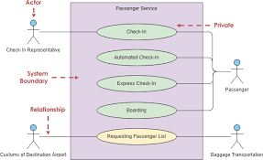
Use Case Diagram

Slide 36
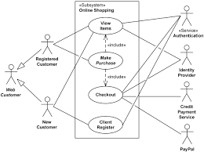
Use Case Diagram

Slide 37
Use Case Diagram
Grade system
Record grades
Student
View grades
Teacher
Distribute
Report cards
Create report cards
Printing administrator

Slide 38

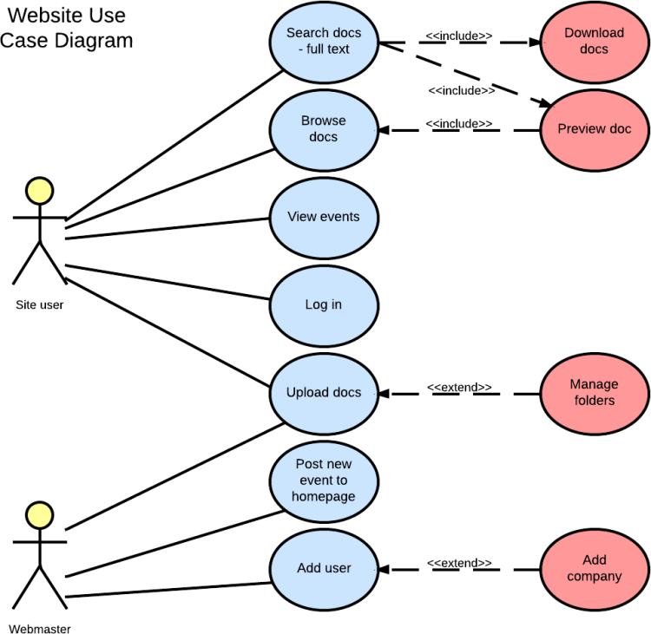
Use Case Diagram
Missing System Boundary

Slide 39

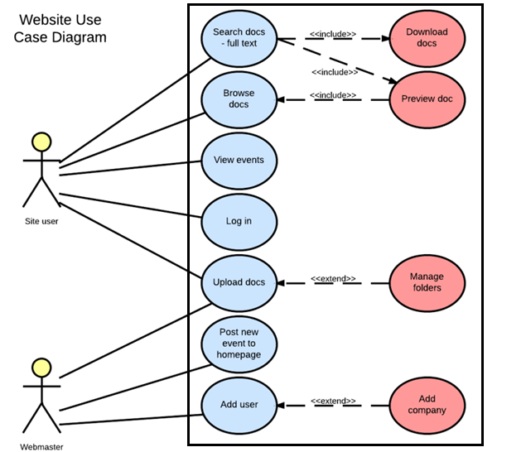
Use Case Diagram
Added System Boundary

Slide 40
Use Case Diagram
Use Case Vs Scenarios
Each use case is one or more scenarios.
Add Subject Use Case :
Scenario 1 : Subject gets added successfully.
Scenario 2 : Adding the subject fails since the subject is already in the database.
Enroll Subject Use Case:
Scenario 1 : Student is enrolled for the subject.
Scenario 2 : Enrollment fails since the student is already enrolled in the subject.
Each scenario has a sequence of steps.

Slide 41
Use Case Diagram
Scenarios
Each scenario has a sequence of steps.
Scenario 1 : Student is enrolled for the subject.
Student chooses the “enroll subject” action.
Check the student has enrolled in less than 10 subjects.
Check if the subject is valid.
Assign the subject to the student.

Slide 42
Use Case Diagram
Scenarios
Each scenario has a sequence of steps.
Scenario 2 : Enrolling fails since the student is already enrolled in 10 subjects.
Student chooses the “enroll subject” action.
Check the student has enrolled in less than 10 subjects.
Return an error message to the student.

